Slide 1
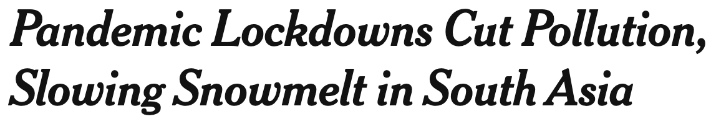
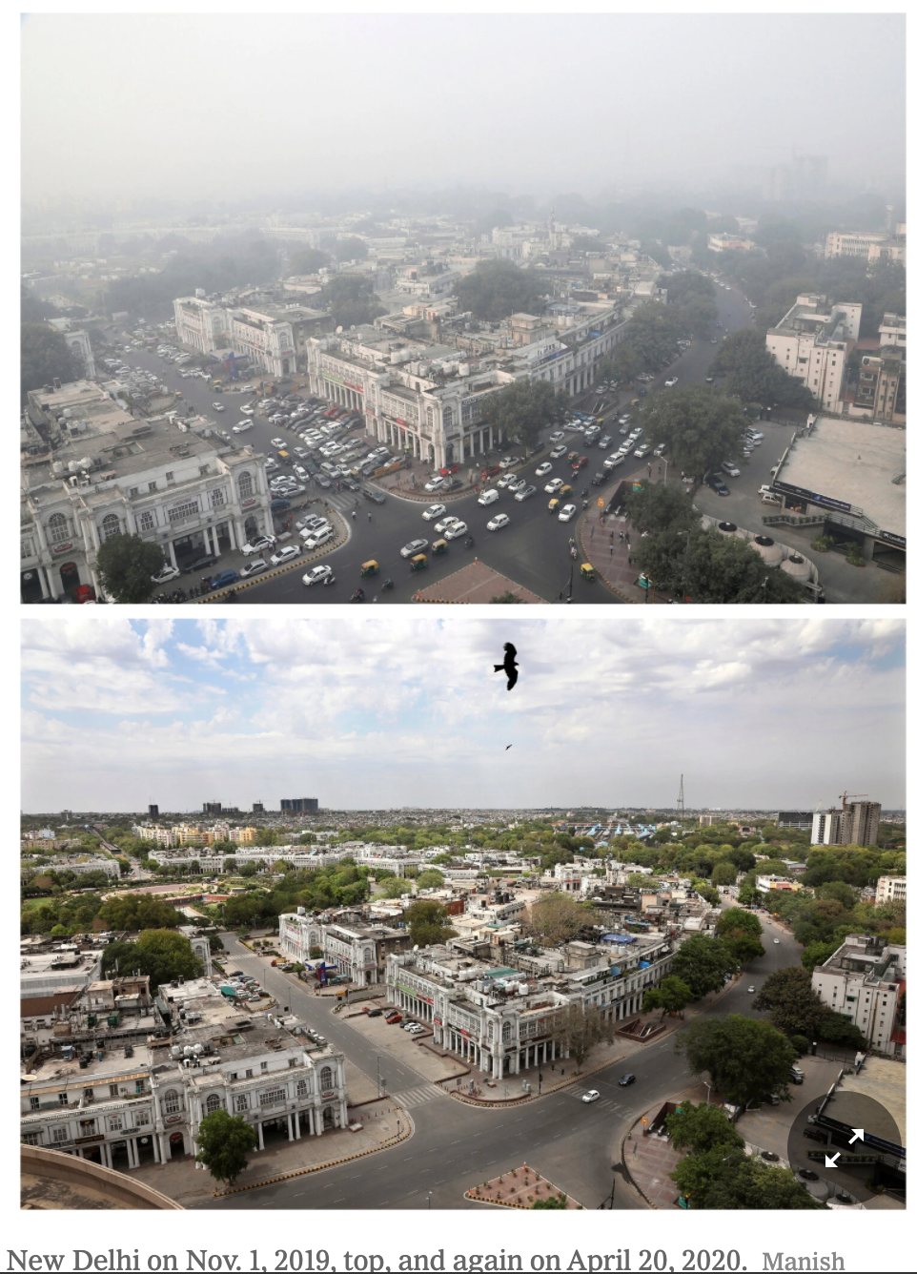
Question: Do lockdowns cut down air pollution?
Data:
Each response value Yi is the measure of the air quality using seven pollutant parameters (PM₁₀, PM_{2.5}, SO₂, NO₂, CO, O₃ and NH₃)
Each covariate value Xi is the number of days in lockdown
Data came from 34 monitoring stations spread throughout Delhi, India during their lockdown from 24th March to 3rd May 2020
Conclusion:
The results demonstrated that during lockdown air quality is significantly improved.
Among the pollutants, concentrations of PM₁₀ , PM_{2.5} , NO₂ and have witnessed maximum reduction (>50%) and CO saw a 30.35% reduction compared to the pre-lockdown phase.
About 40% to 50% improvement in air quality is identified just after four days of commencing lockdown.
Keep in mind India is one of the most polluted countries in the world so this might not be a great representative for every place in the world.

